Slide 1
AMES, IOWA
HOUSING
Predicting Sale Prices with Machine Learning
Notes:
Hello and welcome
This is a presentation on demonstrating the feasibility of using machine learning to predict sale prices of homes.

Slide 2

Welcome!
Chris Landschoot
I am a Data Scientist leading the data science team at Zillow
Notes:
My name is Chris Landschoot
I am a Data Scientist leading a team at Zillow focusing on solving this challenge of predicting housing prices.

Slide 3
Background
Real Estate Today:
Currently housing prices are predicted manually by assessors.
This is time consuming and costly.
Digital real estate companies are looking for a way to more efficiently and accurately predict home prices.
Top digital real estate companies (Zillow, Trulia, Redfin, etc…) have agreed to enter a competition to focused on developing the best house price prediction algorithm.
The platform Kaggle is being leveraged to host this competition.
Notes:
Currently housing prices are predicted manually by assessors.
This is time consuming and costly.
So, digital real estate companies are looking for a way to more efficiently and accurately predict home prices.
Top digital real estate companies (Zillow, Trulia, Redfin, etc…) have agreed to enter a competition to focused on developing the best house price prediction algorithm.
The platform Kaggle is being leveraged to host this competition.
This leads us to why we are here today…

Slide 4
PROBLEM STATEMENT
Zillow is seeking to create a proof-of-concept linear regression machine learning model focused on accurately predicting the price of houses at sale.
This model will compete in the real estate Kaggle competition.
Housing data from Ames, IA will be used to prototype this technology.
Notes:
Zillow has tasked my team with creating a proof-of-concept linear regression machine learning model that will use common assessing data to predict house sale prices.
To create this model, and compete in the digital realtor competition, we used a set of data from the Ames, Iowa assessor’s office.

Slide 5

DATASET
From the Ames Assessor’s Office used in computing assessed values for individual residential properties sold in Ames, IA from 2006 to 2010.
81 Features
Numrical
20 Continuous Features
14 Discrete Features
Continuous
25%
Nominal
29%
Categorical
Discrete
18%
23 Nominal Features
23 Ordinal Features
Ordinal
29%
Ames, IA Housing Data: https://jse.amstat.org/v19n3/decock/DataDocumentation.txt
Notes:
The Ames dataset consists of 81 features, one of which was the target, Sale Price.
These features could be separated into 2 types of data, each split into 2 subgroups:
Numerical data, consisting of continuous and discrete features
Categorical data, consisting of nominal and ordinal features
As you can see, the breakdown is relatively evenly distributed with each categorical features taking up 29% individually, continuous at 25%, and discrete at 18%.

Slide 6
DATA SCIENCE PROCESS
01
02
03
04
Data Cleaning & Exploratory Data Analysis (EDA)
Pre-processing & Feature Engineering
Fix data errors and visually explore the data
Manipulate the data and create new features
Model
Evaluation
Conclusions & Recommendations
Test and tune different models
Interpret the model findings and provide insight
Notes:
To create a proper machine learning model, an iterative process must be followed.
First, data must be cleaned and analyzed. Visualizing the data during this process is helpful to identify trends and potential issues with the data.
Once clean, the data can be manipulated to create to features (or categories) that can illuminate trends that may be hidden within the data. The data must also be processed (or formatted) appropriately to input into a machine learning model.
Once the data has been appropriately processed, various models can be tested, analyzed, and tuned.
Finally, when a model has been selected, it can be used to provide insight into the problem at hand. It is important to also note the limitations of the selected model.
These steps are not set in stone, and this is an iterative process that typically requires multiple adjustments at each step.

Slide 7
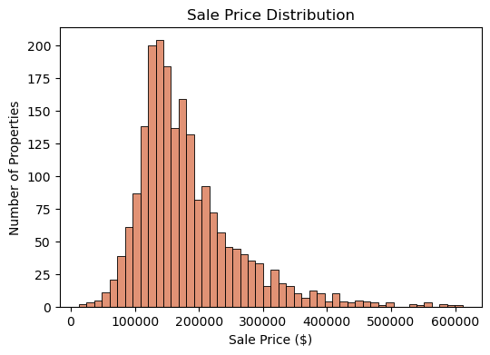
Sale Price Distribution
EDA
Notes:
As we began our Exploratory Data Analysis (or EDA), we discovered that the sale price distribution was right skewed. This demonstrates that a majority of the housing prices resided in the $100k to $200k range, but there were multiple houses that extended far above that range.
Though several of these houses could be considered “outliers” by some metrics, we decided not to remove them as we felt they still contained valuable information.

Slide 8
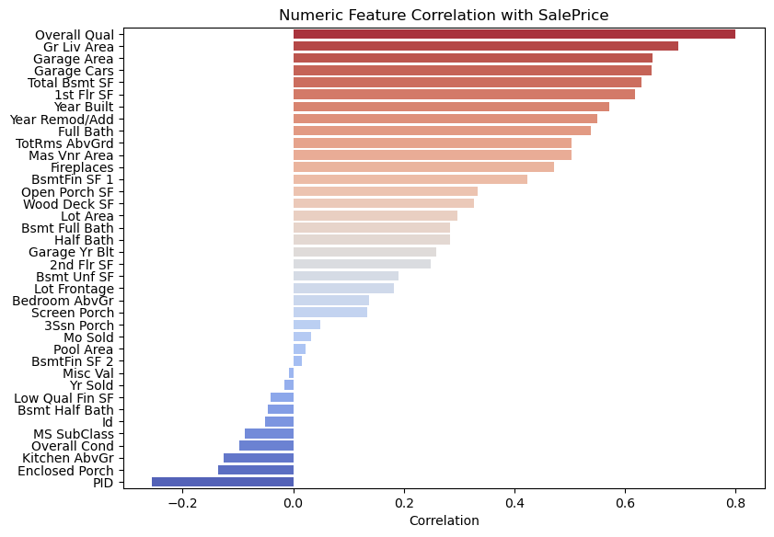
Range of Feature Correlation
EDA
Notes:
We also took a look at how each numeric feature that was provided was correlated to the Sale Price of a home.
Features, such as “Overall Quality” and “Total living area above grade”, seen at the top of the graph were highly correlated with Sale Price.
Though there were several values with a far lower correlation (or negative correlation), we did not drop these features, but instead used many of them in our feature engineering.

Slide 9
Feature Engineering
One-Hot Features
Convert nominal categories to columns of 1s and 0s
Mapping Ordinal Features
Converting categorical features with a natural scale to numbers
Engineered Features
Adding multiple features together to create new features
Polynomial Features
Multiplying and squaring features to determine interaction between features
Notes:
Once our data was clean, it needed to be processed (or formatted) properly to input into a linear regression model.
Linear regression models cannot accept categorical data (for example the type of exterior finish on a house). So, this data needs to be converted to something a computer can process.
For example, we used One-Hot encoding to create numeric values (1 for its presence, 0 for absence). Then features, like Neighborhoods, can be mapped to these values.
We also mapped ordinal features, categories that have a ranking system (like good, better, best), to a numeric scale.
There were several features that we also created (or engineered) from existing feature, such as total bathrooms
This adds all of the bathrooms in a house, counting 1 for each full bathroom and 0.5 for each half bathroom
We also were interested in the interaction between several features, so we created polynomial features, which multiplies different features together to capture how they interact.

Slide 10
Models
Ordinary Least Squares (OLS)
Ridge Regression
LASSO Regression
No Regularization
L2 Regularization
L1 Regularization
NOTE: Regularization helps models generalize better to new unseen data
Notes:
With our processed data, we tested three different types of linear regression models.
Ordinary least squares (OLS)
Ridge Regression
LASSO Regression
The key difference between these models is how they regularize the data. Regularization is essentially adding penalties to certain features in order to better generalize a model.
So while penalizing a model technically reduces performance, this reduction comes with a tradeoff for better robustness.
OLS does not introduce any penalties and typically performs best on the training data, but does not generalize to new information quite as well.
Ridge regression regularizes using an L2 (or squared) penalty term
LASSO regularizes using an L1 (not squared) penalty term

Slide 11
Conclusions
The OLS model performed the best on the training data.
The Ridge model performed the best on unseen data.
The Ridge model is selected because it generalizes best to new data.
Final metric:
R² ~ 95% of the variability in Sale Price can be explained by our model, all else held constant.
Notes:
After testing and tuning all three models, the OLS model performed the best on the training data, but did not generalize to the unseen testing data as well as the other models.
The Ridge model performed the best on new test data, so this was selected as the submission model.
To measure our final model, we analyzed its R2 score of 0.95. This means that approximately 95% of the variability in Sale Price can be explained by our model, all else held constant.

Slide 12
Recommendations
The prototype proved successful.
Zillow should allocate financial resources toward developing this predictive technology.
Resources should be distributed to collecting larger and better data sets as well as continuing to refine and improve the model.
NOTE: This model is specifically targeted to predict home price.
If there is interest in predicting how a single factor affects home price, a less complex model should be developed.
Notes:
The success of our prototype demonstrated that applying linear regression machine learning techniques to the housing market can produce accurate predictions for sale prices of homes.
Because of this, we recommend that Zillow allocate financial resources toward further developing this technology.
Resources should be distributed to collecting more and better data as well as continuing to improve the model
We also need to mention the limitations of this model. This prototype was specifically targeted at predicting home prices, nothing else.
If there is interest in predicting how a single factor affects home price, for example adding a finished basement, then a different and less complex model should be developed.

Slide 13
THANKS!
Any questions?
Notes:
Thank you for you time.
Are the any questions?

